Slide 1
CSCE 3600 Principles of Systems Programming Interprocess Communication Part 2
University of North Texas

Slide 2

What are Sockets?
Sockets are an extension of pipes, with the advantages that processes don’t need to be related, or even on the same machine
Method for accomplishing interprocess communication
Bidirectional communication
A socket is like the end point of a pipe – in fact, the Linux kernel implements pipes as a pair of sockets
Two (or more) sockets must be connected before they can be used to transfer data

Slide 3
Socket Client-Server Model
IPC using sockets described as client-server model
One process is usually called the server
A server process is usually responsible for satisfying requests made by other processes called clients
A server usually has a well-known address (e.g., IP address or pathname)
response
Client
Server
request

Slide 4
Socket Attributes
Sockets are characterized by three attributes
Domain
Type
Protocol
For communication between processes, sockets can be implemented in the following domains
UNIX (e.g., AF_UNIX)
Processes are on the same machine
INET (e.g., AF_INET)
Each process is on a different machine (i.e., requires a network interface device)
Socket Protocol
Determined by socket type and domain
Default protocol is 0

Slide 5
Socket Attributes
Three main types of sockets:
SOCK_STREAM (TCP sockets)
Provides a connection-oriented, sequenced, reliable, and bidirectional network communication service
E.g., telnet, ssh, http
SOCK_DGRAM (UDP sockets)
Provides a connectionless, unreliable, best-effort network communication service
E.g., streaming audio/video, IP telephony
SOCK_RAW
Allows direct access to other layer protocols such as IP, ICMP, or IGMP

Slide 6

Unix Domain Stream Sockets

Slide 7
UNIX Domain Sockets
Socket for communicating with another process on the same machine only
Provides an optimization since no network overhead
Uses sockaddr_un structure instead of sockaddr_in
#include <sys/un.h>
struct sockaddr_un
{
sa_family_t sun_family; /* AF_UNIX */
char sun_path[108]; /* pathname */
};

Slide 8
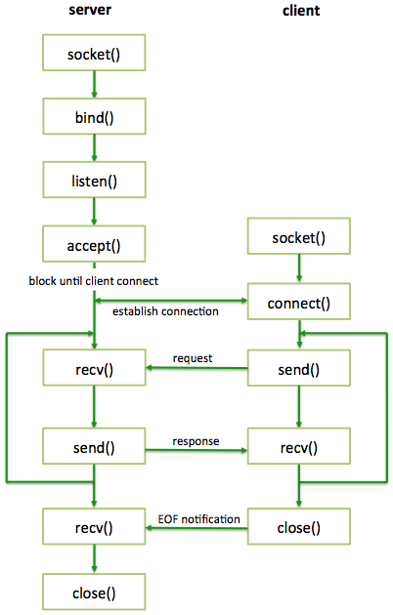
Stream Socket
Sequence of function calls for a client and server to implement a stream socket

Slide 9
Steps in Server Process
Call socket() with proper arguments to create the socket
Call bind() to bind the socket to an address (in our case, it is just a pathname) in the UNIX domain
Call listen() to instruct the socket to listen for incoming connections from client programs
Call accept() to accept a connection from a client
Handle the connection and loop back to accept()
Close the connection

Slide 10
Steps in Client Process
Call socket() to get a UNIX domain socket to communicate through
Set up a struct sockaddr_un with the remote address (where the server is listening) and call connect() with that as an argument
Assuming no errors, you are connected to the remote side
Use send() and recv() to communicate

Slide 11
Creating the Socket
#include <sys/types.h>
#include <sys/socket.h>
int socket(int domain, int type, int protocol);
Creates an endpoint for communication (i.e., a socket) and returns a file descriptor
Common domains (or address family)
AF_UNIX Unix domain sockets
AF_INET IPv4 Internet sockets
AF_INET6 IPv6 Internet sockets
Type
SOCK_STREAM, SOCK_DGRAM, SOCK_RAW
Protocol
Set to 0 (chosen by OS) except for RAW sockets

Slide 12
Bind to a Name (Server Side)
#include <sys/types.h>
#include <sys/socket.h>
int bind(int sockfd, const struct sockaddr *serveraddr, socklen_t addrlen);
Binds a name to the socket (i.e., reserves a port)
sockfd is the socket file descriptor returned by socket
serveraddr is the IP address and port of the machine (address usually set to INADDR_ANY – chooses a local address)
addrlen is the size (in bytes) of the structure
Returns 0 on success or –1 if an error occurs
When socket is bound, new special socket-type file (type "s") corresponding to sun_path is created
This file is not automatically deleted, so need to unlink it
If bind finds the file already exists, it will fail

Slide 13
Set Up Queue (Server Side)
#include <sys/types.h>
#include <sys/socket.h>
int listen(int sockfd, int backlog);
Listens for connections on a socket
After calling listen(), a socket is ready to accept connections
Prepares a queue in the kernel where partially completed connections wait to be accepted
Many client requests may arrive
Server cannot handle them all at the same time
Server could reject the requests or let them wait
backlog is the maximum number of partially completed connections that the kernel should queue
What if too many clients arrive?
Some requests don’t get through … makes no promises
And the client(s) can always try again!

Slide 14
Establish Connection (Server Side)
#include <sys/types.h>
#include <sys/socket.h>
int accept(int sockfd, struct sockaddr* cliaddr, socklen_t * addrlen);
Accepts a connection on the socket and returns a new file descriptor that refers to the connection with the client that will be used for reads and writes on the connection
Blocks waiting for a connection (from the queue)
sockfd is the listening socket
cliaddr is the address of the client

Slide 15
Establish Connection (Client Side)
#include <sys/types.h>
#include <sys/socket.h>
int connect(int sockfd, const struct sockaddr* servaddr, socklen_t * addrlen);
Initiates a connection on the socket, where the kernel will select a source IP address and dynamic port
Returns 0 on success or –1 on failure

Slide 16
Sending Data
#include <sys/types.h>
#include <sys/socket.h>
ssize_t send(int sockfd, const void *buf, size_t len, int flags);
Alternative to write that sends a message on the socket
sockfd is socket descriptor for open and connected socket
buf is a buffer of information to send
len is the size of the buffer in bytes
flags
Bitwise OR of zero or more flags (e.g., MSG_EOR, MSG_OOB, etc.)
Calls are blocking (i.e., returns only after data is sent)

Slide 17
Receiving Data
#include <sys/types.h>
#include <sys/socket.h>
ssize_t recv(int sockfd, void *buf, size_t len, int flags);
Alternative to read that receives a message on the socket
sockfd is socket descriptor for open and connected socket
buf is initially empty to store the data
len is the size of the buffer in bytes
flags
Bitwise OR of zero or more flags (e.g., MSG_EOR, MSG_OOB, etc.)
Calls are blocking (returns only after data is received)

Slide 18
Close and Shutdown
#include <unistd.h>
int close(sockfd);
Closes the file descriptor when done
Will not deallocate the socket until we close the last descriptor that references it (we may have several)
#include <sys/socket.h>
int shutdown(int sockfd, int how);
Forces a full or partial closure of a socket
sockfd is a socket descriptor
how can be SHUT_RD, SHUT_WR, or SHUT_RDWR

Slide 19
Socket Pair

Slide 20
Socket Pipe
What if you wanted a pipe(), but you wanted to use a single pipe to send and receive data from both sides?
Since most pipes are unidirectional (with exceptions in SYSTEM V), you cannot do it!
Unix System V is one of the first commercial versions of the Unix OS
UNIX domain sockets can handle bi-directional data
But, you would have to set up all that code with listen() and connect() with everything just to pass data both ways
However, you can use socketpair() that returns a pair of already connected sockets
No extra work needed and you can immediately use the socket descriptors for interprocess communication (only available in UNIX domain socket)

Slide 21
socketpair() Function
#include <sys/socket.h>
int socketpair(int family, int type, int protocol, int sockfd[2]);
Creates two unnamed sockets that are already connected (Unnamed: A stream socket that has not been bound to a pathname using bind(2) has no name)
They are full-duplex (i.e., data can go in each direction)
Also called stream pipes if type is SOCK_STREAM
Returns 0 on success, –1 on error
Family must be AF_LOCAL or AF_UNIX
Type is SOCK_DGRAM or SOCK_STREAM
Protocol must be 0

Slide 22
Internet Stream Sockets

Slide 23
Layers of the IP Protocol Suite
ftp
Application Layer
Application Layer
Transport Layer
TCP, UDP
Transport Layer
IP
Network Layer
Network Layer
Link Layer
Ethernet
Link Layer

Slide 24
Protocol Suite Location
Internet Protocol Layer
Location
Applications (e.g., browser, game, ftp)
Application Layer
Operating System (e.g., Unix)
Application Programming Interface (API) (e.g., network API)
Transport Layer (TCP, UDP)
Network Layer (IP)
Network Card & Device Driver (e.g., Ethernet card)
Interface to the Network Card
Link Layer

Slide 25
Internet Sockets
Sockets provide a mechanism to communicate between computers across a network
Internet Sockets
AF_INET – the addresses are IPv4 addresses
AF_INET6 – the addresses are IPv6 addresses
controlled by
application
developer
controlled by
application
developer
process
process
socket
socket
TCP with
buffers,
variables
TCP with
buffers,
variables
controlled by
operating
system
controlled by
operating
system
internet
host or
server
host or
server

Slide 26
What is the Internet?
Physical layer
Actual electrons on a wire
Datalink layer
Frames
MAC Addresses
Network layer
Router to router
Creates network IP addresses
Variable length packets
Transport layer
Persistent communication channels
TCP, UDP, ports
Session layer
Open, close, manage sessions
AppleTalk, SCP
Presentation layer
String encoding,encryption/decryption
Object serialization, files, compression
Application layer
HTTP
POST and GET requests

Slide 27
Byte Ordering of Integers
Different CPU architectures have different byte ordering. Byte ordering is an attribute of the processor, not the operating system running on it.
In computing, endianness is the order or sequence of bytes of a word of digital data in computer memory.
Endianness is expressed as big-endian or little-endian
Endianness may also be used to describe the order in which the bits are transmitted over a communication channel, e.g., big-endian in a communications channel transmits the most significant bits first
Little-Endian
Stores the least significant byte (LSB) in the smallest address
Big-Endian
Stores the most significant byte (MSB) in the smallest address
In order to connect to a remote computer and use a socket, we need to use its address
In fact, Linux is little-endian, but TCP/IP uses big-endian byte ordering

Slide 28
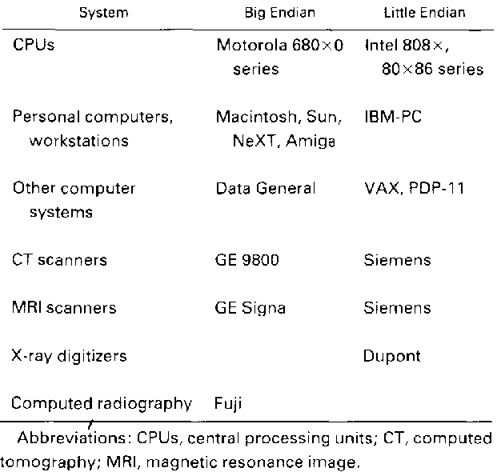
Examples of systems in different byte ordering
Source: Gillespy and Rowberg 1993, table 2.

Slide 29
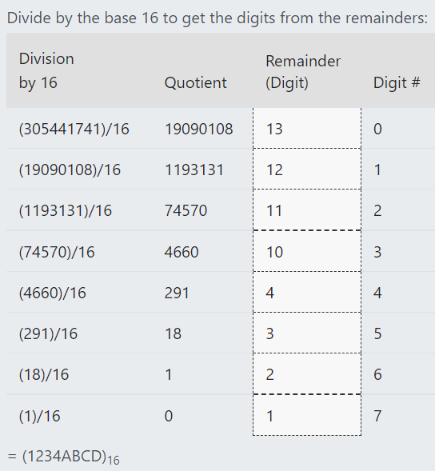
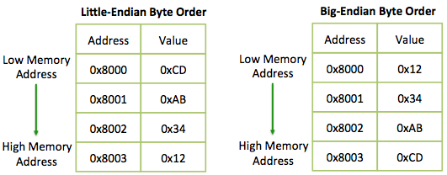
Byte Ordering
Suppose we wanted to store the integer 305,441,741
Converts to 1234ABCD₁₆

Slide 30
Byte Ordering
A byte (of 8 bits) has a limited range of 256 values. When a value is beyond this range, it has to be stored in multiple bytes.
A number such as 753 in hexadecimal format is 0x02F1. It requires at least two bytes of storage. The order in which these two bytes are stored in memory can be different. Byte 0x02 can be stored in lower memory address followed by 0xF1; or vice versa.
Programs must conform to the byte ordering as supported by the processor. If not, 0x02F1 might be wrongly interpreted as 0xF102, which is the number 61698 in decimal system. Byte ordering is also important when data is transferred across a network or between systems using different ordering.

Slide 31
Byte Ordering of Integers
memory address A + 1
memory address A
Stored at little-endian computer
high-order byte
low-order byte
Integer representation (2 byte)
D3
F2
Stored at big-endian computer
low-order byte
high-order byte

Slide 32
Byte Ordering Problem
What would happen if two computers with different integer byte ordering communicate?
Nothing… if they do not exchange integers!
But... if they exchange integers, they would get the wrong order of bytes, and therefore, the wrong value!
Message is: [HELLO,1]
Message is: [HELLO,256]
Processing
Processing
Message in Memory of little-endian Computer
Message in Memory of of big-endian Computer
Message is sent
across Network
48 45 4C 4C 6F 01 00
48 45 4C 4C 6F 01 00

Slide 33
Byte Ordering Solution
There are two solutions if computers (hosts) with different byte ordering system want to communicate
They must know the kind of architecture of the sending computer
Bad solution, it has not been implemented
Introduction of a network byte order. The functions are:
uint16_t htons(uint16_t host16bitvalue)
uint32_t htonl(uint32_t host32bitvalue)
uint16_t ntohs(uint16_t net16bitvalue)
uint32_t ntohl(uint32_t net32bitvalue)
Use for all integers (short and long) that are sent across the network
Including port numbers and IP addresses
host to network short host to network long network to host short
network to host long

Slide 34
Network Byte Ordering Solution
A host system may be little-endian but when sending data into the network, it must convert data into big-endian format.
Likewise, a little-endian machine must first convert network data into little-endian before processing it.
Four common functions to do these conversions are (for 32-bit long and 16-bit short) htonl, ntohl, htons and ntohs.

Slide 35
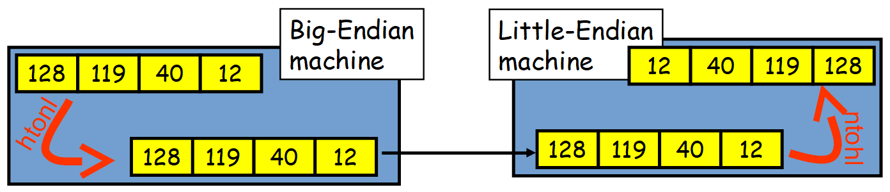
Byte Ordering Solution
Network addresses in a given network must all follow a consistent addressing convention.
This convention, known as network byte order, defines the bit-order of network addresses as they pass through the network.
The TCP/IP standard network byte order is big-endian.
In order to participate in a TCP/IP network, little-endian systems usually bear the burden of conversion to network byte order.

Slide 36
Naming and Addressing
Host name
Identifies a single host
Variable length string (e.g., www.unt.edu, cse01)
Is mapped to one or more IP addresses
IP Address (IPv4)
Written as dotted octets (e.g., 10.0.0.1)
32 bits – not a number, but often needs to be converted to a 32-bit number to use
Port number
Identifies a process on a host
16 bit number

Slide 37

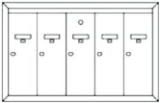
Addresses, Ports, and Sockets
Like apartments and mailboxes
You are the application
Street address of your apartment building is the IP address
Your mailbox is the port
The post-office is the network
The socket is the key that gives you access to the right mailbox
How do you choose which port a socket connects to?
1 2 3 4 5

Slide 38
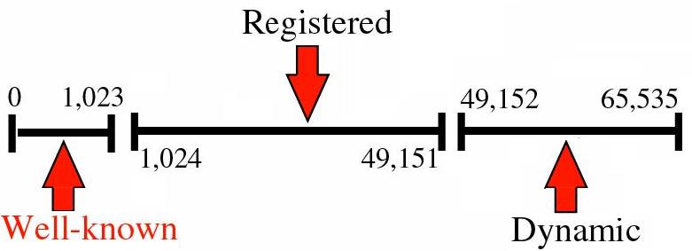
Port Numbers
You can find a list of all IANA registered ports at: Internet Assigned Numbers Authority
http://www.iana.org/assignments/service-names-port-numbers/service-names-port-numbers.xhtml

Slide 39
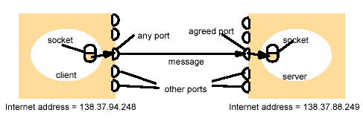
Addresses, Ports, and Sockets
Choose a port number that is registered for general use, from 1024 to 49151
Do not use ports 0 to 1023. These ports are reserved (must be root) for use by the Internet Assigned Numbers Authority (IANA)
Avoid using ports 49152 through 65535. These are dynamic ports that operating systems use randomly
If you choose one of these ports, you risk a potential port conflict
Client
Server

Slide 40
IP Address Data Structure
The sockaddr_in structure has four parts
struct sockaddr_in
{
short int sin_family; // address family
unsigned short int sin_port; // port number
struct in_addr sin_addr; // Internet address
unsigned char sin_zero[8]; // set to 0, padding
};
struct in_addr
{
unsigned long s_addr; // 4 bytes
};
https://man7.org/linux/man-pages/man7/ip.7.html

Slide 41
IP Address Data Structure
Declare address structure
struct sockaddr_in sockAdd;
Set family
sockAdd.sin_family = AF_INET;
Set IP address (2 ways)
// specify address to listen to
inet_pton(AF_INET, "127.0.0.1", &sockAdd.sin_addr.s_addr)‏
// listen to any local address
sockAdd.sin_addr.s_addr = htonl(INADDR_ANY)
Set port
sockAdd.sin_port = htons(9999);
inet_pton - convert IPv4 and IPv6 addresses from text to binary form
Notes:
https://man7.org/linux/man-pages/man3/inet_pton.3.html

Slide 42
Network Addressing Library Routines
#include <sys/socket.h>
#include <netinet/in.h>
#include <arpa/inet.h>
in_addr_t inet_addr(const char* string)
Converts an IP address in IPv4 numbers-and-dots notation into binary form in network byte order
If string does not contain legitimate Internet address, returns value INADDR_NONE
#include <unistd.h>
int gethostname(char* name, int nameLen)
Gets the null-terminated hostname as a character array along with its length in bytes

Slide 43
Network Addressing Library Routines
#include <sys/socket.h>
#include <netinet/in.h>
#include <arpa/inet.h>
int inet_aton(const char *cp, struct in_addr *inp);
Converts an IP address in IPv4 numbers-and-dots notation into binary form in network byte order and stores it in an in_addr struct
#include <sys/socket.h>
#include <netinet/in.h>
#include <arpa/inet.h>
char *inet_ntoa(struct in_addr in);
Converts an IP address in the in_addr struct in network byte order into a string in IPv4 dotted-decimal notation
Notes:
https://man7.org/linux/man-pages/man3/inet_aton.3.html

Slide 44
Other Library Routines
#include <arpa/inet.h>
const char *inet_ntop(int af, const void *src, char *dst, socklen_t cnt);
Converts a network address, either IPv4 or IPv6, from its binary to text form
#include <arpa/inet.h>
int inet_pton(int af, const char *src, void *dst);
Converts a network address, either IPv4 or IPv6, from its text to binary form

Slide 45
Datagram Sockets

Slide 46
TCP vs. UDP
TCP
Reliable byte stream service
Different ways to build clients and servers
Some problems when building clients/servers with TCP
How to get around blocking I/O
Data format conversion
Basic assumption: whatever sent will eventually be received!!
UDP
Unreliable datagram service
Data may get lost – application may need to deal with more details in the communication

Slide 47
Why UDP?
Applications that do not need 100% reliability communication
E.g., VoIP, video stream, DNS servers
Applications care a lot about performance
High performance computing (TCP cares too much about other things than performance)
Applications that need multicast or broadcast
TCP only supports point to point communication

Slide 48
UDP Client/Server
Typical UDP client
Client does not establish a connection with the server
Client sends a datagram to the server using sendto function
Typical UDP server
Does not accept a connection from a client
Server calls recvfrom function that waits until data arrives from some client

Slide 49
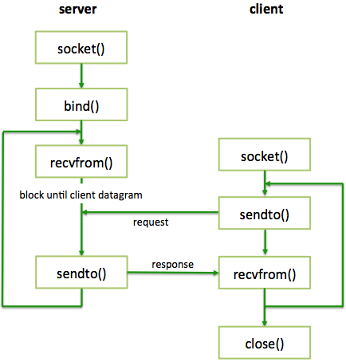
Datagram Socket
Sequence of function calls for a client and server to implement a datagram socket
No “handshake”
No simultaneous close
A datagram socket provides a symmetric data exchange interface without requiring connection establishment. Each message carries the destination address.

Slide 50
Receiving a Message
#include<sys/socket.h>
ssize_t recvfrom(int sockfd, void *buff, size_t nbytes, int flags,struct sockaddr *from, socklen_t *addrlen);
Receives a message on the socket
If recvfrom is successful, the number of bytes read is returned, -1 on error

Slide 51
Sending a Message
#include <sys/socket.h>
ssize_t sendto(int sockfd, const void *buff, size_t nbytes, int flags, const struct sockaddr *to, socklen_t addrlen);
Sends a message on the socket
If sendto is successful, the number of bytes written, even if 0 bytes are written, is returned, -1 on error

Slide 52
The following example code shows how to send an Internet call by creating a socket, binding a name to the socket, and sending the message to the socket.
#include <sys/types.h>
#include <sys/socket.h>
#include <netinet/in.h>
#include <netdb.h>
#include <stdio.h>
#include <stdlib.h>
#include <string.h>
#include <unistd.h>
#define DATA "The sea is calm, the tide is full . . ."
/*
* Here I send a datagram to a receiver whose name I get from
* the command line arguments. The form of the command line is:
* dgramsend hostname portnumber
*/
int main(int argc, char *argv[])
{
int sock, errnum;
struct sockaddr_in name;
struct addrinfo hints, *result, *rp;
/* Create socket on which to send. */
sock = socket(AF_INET,SOCK_DGRAM, 0);
if (sock == -1) {
perror("opening datagram socket");
exit(1);
}
memset(&hints, 0, sizeof(struct addrinfo));
hints.ai_family = AF_INET; /* IPv6 address family */
hints.ai_socktype = SOCK_DGRAM; /* datagram socket */
hints.ai_flags = 0;
hints.ai_protocol = 0; /* Any protocol */
errnum = getaddrinfo(argv[1], argv[2], &hints, &result);
if (errnum != 0) {
fprintf(stderr, "getaddrinfo: %s\n", gai_strerror(errnum));
exit(1);
}
/* Send message to all addresses returned by getaddrinfo() */
for (rp = result; rp != NULL; rp = rp->ai_next) {
/* Construct name, with no wildcards, of the socket to ``send'' to. */
bzero(&name, sizeof (name));
memcpy((char *) &name.sin_addr, (char *) &((struct sockaddr_in *)rp->ai_addr)->sin_addr,
sizeof(name.sin_addr));
name.sin_family = AF_INET;
name.sin_port = htons(atoi(argv[2]));
/* Send message. */
if (sendto(sock, DATA, sizeof DATA, 0,
(struct sockaddr *) &name, sizeof name) == -1)
perror("sending datagram message");
}
freeaddrinfo(result); /* Free the memory allocated by getaddrinfo() */
close(sock);
return 0;
Sending an Internet Family Datagram
send.c

Slide 53
Send from file
#include <sys/types.h>
#include <sys/socket.h>
#include <netinet/in.h>
#include <netdb.h>
#include <stdio.h>
#include <stdlib.h>
#include <string.h>
#include <unistd.h>
int main(int argc, char *argv[])
{
int sock, errnum;
struct sockaddr_in name;
struct addrinfo hints, *result, *rp;
FILE *file; // File pointer for reading data
char buffer[1024]; // Buffer for storing data from the file
if (argc != 4) {
fprintf(stderr, "Usage: %s hostname portnumber filename\n", argv[0]);
exit(1);
}
// Open the file for reading
file = fopen(argv[3], "r");
if (file == NULL) {
perror("opening file");
exit(1);
}
// Create socket on which to send.
sock = socket(AF_INET, SOCK_DGRAM, 0);
if (sock == -1) {
perror("opening datagram socket");
exit(1);
}
memset(&hints, 0, sizeof(struct addrinfo));
hints.ai_family = AF_INET;
hints.ai_socktype = SOCK_DGRAM;
hints.ai_flags = 0;
hints.ai_protocol = 0;
errnum = getaddrinfo(argv[1], argv[2], &hints, &result);
if (errnum != 0) {
fprintf(stderr, "getaddrinfo: %s\n", gai_strerror(errnum));
exit(1);
}
// Send message to all addresses returned by getaddrinfo()
while (fgets(buffer, sizeof(buffer), file) != NULL) {
for (rp = result; rp != NULL; rp = rp->ai_next) {
bzero(&name, sizeof(name));
memcpy((char *)&name.sin_addr, (char *)&((struct sockaddr_in *)rp->ai_add>
sizeof(name.sin_addr));
name.sin_family = AF_INET;
name.sin_port = htons(atoi(argv[2]));
// Send data from the buffer
if (sendto(sock, buffer, strlen(buffer), 0,
(struct sockaddr *)&name, sizeof(name)) == -1)
perror("sending datagram message");
}
}
freeaddrinfo(result);
close(sock);
fclose(file); // Close the file
return 0;
}

Slide 54
The following sample code shows how to read an Internet call by creating a socket, binding a name to the socket, and then reading from the socket.
#include <sys/types.h>
#include <sys/socket.h>
#include <netinet/in.h>
#include <stdio.h>
#include <stdlib.h>
#include <unistd.h>
#include <string.h>
/* This program creates a datagram socket, binds a name to it, then
* reads from the socket. */
int main()
{
int sock, length;
struct sockaddr_in6 name;
char buf[1024];
/* Create socket from which to read. */
sock = socket(AF_INET6, SOCK_DGRAM, 0);
if (sock == -1) {
perror("opening datagram socket");
exit(1);
}
/* Create name with wildcards. */
bzero (&name, sizeof (name));
name.sin6_family = AF_INET6;
name.sin6_addr = in6addr_any;
name.sin6_port = 0;
if (bind (sock, (struct sockaddr *)&name, sizeof (name)) == -1) {
perror("binding datagram socket");
exit(1);
}
/* Find assigned port value and print it out. */
length = sizeof(name);
if (getsockname(sock,(struct sockaddr *) &name, &length)
== -1) {
perror("getting socket name");
exit(1);
}
printf("Socket port #%d\n", ntohs(name.sin6_port));
/* Read from the socket. */
if (read(sock, buf, 1024) == -1 )
perror("receiving datagram packet");
/* Assumes the data is printable */
printf("-->%s\n", buf);
close(sock);
exit(0);
}
Reading Internet Family Datagrams
receive.c

Slide 55
Receive continuously
#include <sys/types.h>
#include <sys/socket.h>
#include <netinet/in.h>
#include <stdio.h>
#include <stdlib.h>
#include <unistd.h>
#include <string.h>
int main()
{
int sock, length;
struct sockaddr_in6 name;
char buf[1024];
// Create socket from which to read.
sock = socket(AF_INET6, SOCK_DGRAM, 0);
if (sock == -1) {
perror("opening datagram socket");
exit(1);
}
// Create name with wildcards.
bzero(&name, sizeof(name));
name.sin6_family = AF_INET6;
name.sin6_addr = in6addr_any;
name.sin6_port = 0;
if (bind(sock, (struct sockaddr *)&name, sizeof(name)) == -1) {
perror("binding datagram socket");
exit(1);
}
// Find assigned port value and print it out.
length = sizeof(name);
if (getsockname(sock, (struct sockaddr *)&name, &length) == -1) {
perror("getting socket name");
exit(1);
}
printf("Socket port #%d\n", ntohs(name.sin6_port);
while (1) {
// Read from the socket.
int bytes_received = read(sock, buf, sizeof(buf));
if (bytes_received == -1) {
perror("receiving datagram packet");
} else {
buf[bytes_received] = '\0'; // Null-terminate the received data
printf("-->%s\n", buf);
}
}
close(sock);
exit(0);
}

Slide 56
Blocking and Nonblocking
Blocking refers to the process of how the program will wait for bytes to appear on the input stream
When blocking is turned on, every function call for input will wait until data appears on the input stream. The program will not continue until input is received.
When blocking is turned off, the function call will check to see if data is present. If data is present, read occurs normally, just as if blocking were turned on.
However, if no data is present, the function call will return immediately and inform the program that no data is present. This allows the program to continue whether input data is present or not.

Slide 57
Blocking and Nonblocking
Examples of
a. blocking interprocess communication
- disk data request - network data transfer - anything with a data dependency
b. nonblocking interprocess communication
- mode change
Notes:
-If a process needs to read data from a disk, it may need to wait for the disk to spin up and the data to be read before the process can continue
-When a process sends or receives data over a network, it may need to wait for the data to be transferred before it can proceed.
Non blocking
- A process can send a message to another process to request a change in mode or state. The receiving process can choose to handle the request at its leisure, without blocking the sender.

Slide 58
Blocking and Nonblocking
Program
: get input :
Program
: get input :
Keyboard
Keyboard
(continue if no data present)
(wait)
Blocking
Non-blocking
Fig: Types of blocking on an input stream

Slide 59
Blocking and Nonblocking
Being able to control blocking is important in a number of situations.
For e.g.: a banking machine typically does not wait forever for a user to enter a password, or to command a transaction. After waiting a fixed amount of time, a banking machine program typically continues to a portion of the program that ends the banking session, in order to protect the user. This is an example of timed blocking.

Slide 60
Blocking and Nonblocking
Consider a movie-playing program (E.g. VLC Media player, Windows Media Player etc).
A user expects to be able to rewind, pause, and interact with a film while it is playing back. This can be accomplished through nonblocking input.

Slide 61
I/O Multiplexing

Slide 62
Definition
I/O multiplexing is typically used in networking applications in the following scenarios:
When a client is handling multiple descriptors (normally interactive input and a network socket)
When a client to handle multiple sockets at the same time (this is possible, but rare)
If a TCP server handles both a listening socket and its connected sockets
If a server handles both TCP and UDP
If a server handles multiple services and perhaps multiple protocols
I/O multiplexing is not limited to network programming. Many nontrivial applications find a need for these techniques.

Slide 63
Definition
There are normally two distinct phases for an input operation:
1.Waiting for the data to be ready. This involves waiting for data to arrive on the network. When the packet arrives, it is copied into a buffer within the kernel.
2.Copying the data from the kernel to the process. This means copying the (ready) data from the kernel's buffer into our application buffer

Slide 64
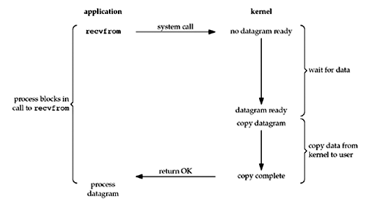
Blocking I/O Model
The most prevalent model for I/O is the blocking I/O model.
By default, all sockets are blocking.
In the figure above, the process calls recvfrom and the system call does not return until the datagram arrives and is copied into our application buffer, or an error occurs
We say that the process is blocked the entire time from when it calls recvfrom until it returns. When recvfrom returns successfully, our application processes the datagram.

Slide 65
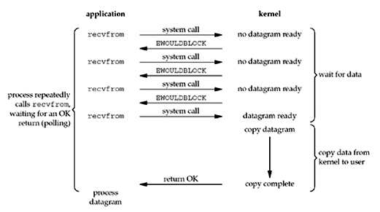
Nonblocking I/O Model
When a socket is set to be nonblocking, we are telling the kernel "when an I/O operation that I request cannot be completed without putting the process to sleep, do not put the process to sleep, but return an error instead".
For the first three recvfrom, there is no data to return and the kernel immediately returns an error of EWOULDBLOCK.
For the fourth time we call recvfrom, a datagram is ready, it is copied into our application buffer, and recvfrom returns successfully. We then process the data.
Notes:
When an application sits in a loop calling recvfrom on a nonblocking descriptor like this, it is called polling. The application is continually polling the kernel to see if some operation is ready. This is often a waste of CPU time, but this model is occasionally encountered, normally on systems dedicated to one function.

Slide 66
Dealing with Blocking Calls
Many functions block
accept until a connection comes in
connect until the connection is established
recv, recvfrom until a packet (of data) is received
send, sendto until data is pushed into socket’s buffer
For simple programs, this is fine
What about complex connection routines?
Multiple connections
Simultaneous sends and receives
Simultaneously doing non-networking processing

Slide 67
Dealing with Blocking Calls
Options
Create multi-process or multi-threaded code
Turn off blocking feature (e.g., use fcntl() file-descriptor control system call)
Use the select() function
What does select() do?
Can be permanent blocking, time-limited blocking, or non-blocking
Input is a set of file descriptors
Output is information on the file-descriptors’ status
Therefore, can identify sockets that are “ready for use” so that calls involving that socket will return immediately

Slide 68
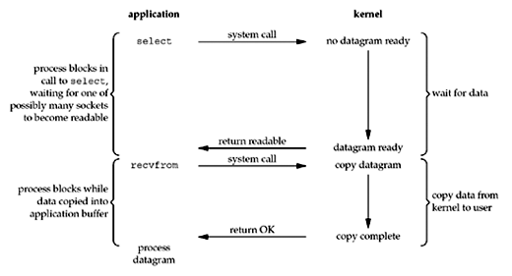
I/O Multiplexing Model
With I/O multiplexing, we call select or poll and block in one of these two system calls, instead of blocking in the actual I/O system call.
We block in a call to select, waiting for the datagram socket to be readable.
When select returns that the socket is readable, we then call recvfrom to copy the datagram into our application buffer.

Slide 69
I/O Multiplexing Model Vs Blocking Model
Comparing to the blocking I/O model
Disadvantage: using select requires two system calls (select and recvfrom) instead of one
Advantage: we can wait for more than one descriptor to be ready

Slide 70
I/O Blocking
socket();
bind() ;
listen();
while
accept();
recv();
send();
Simple server has blocking problem
Suppose 5 connections accepted (5 times, while has run successfully)
Suppose 6th accept() blocks
Other connections cannot receive and send
Cannot get keyboard input either

Slide 71
I/O Multiplexing
select() waits on multiple file descriptors and timeout
Returns when any file descriptor
Is ready to be read, or
Written, or
Indicates an error, or
Timeout exceeded
Advantages
Simple
Application does not consume CPU cycles while waiting
Disadvantages
Does not scale to large number of file descriptors
socket();
bind() ;
listen();
while
accept();
recv();
send();
wait for select()

Slide 72
select Function Call
The select function allows the process to instruct the kernel to either:
1.Wait for any one of multiple events to occur and to wake up the process only when one or more of these events occurs, or
2.When a specified amount of time has passed.
This means that we tell the kernel what descriptors we are interested in (for reading, writing, or an exception condition) and how long to wait. The descriptors in which we are interested are not restricted to sockets; any descriptor can be tested using select.

Slide 73
select Function Call
#include <sys/types.h>
#include <sys/socket.h>
int status = select(nfds, &readfds, &writefds, &exceptfds, &timeout);
Provided a list of file descriptors to check the status if they are read-ready, write-ready, or have registered an exception
Returns the number of ready objects, -1 if error
nfds is 1 + largest file descriptor to check
Uses bit-vector structure called fd_set to manage list of file descriptors
readfds list of descriptors to check if read-ready
writefds list of descriptors to check if write-ready
exceptfds list of descriptors to check if an exception is registered
timeout passed to indicate time after which select returns, even if no ready file descriptors

Slide 74
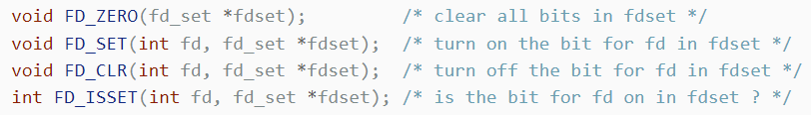
select Function Call
The three middle arguments, readset, writeset, and exceptset (&readfds, &writefds, &exceptfds)specify the descriptors that we want the kernel to test for reading, writing, and exception conditions.
select uses descriptor sets, typically an array of integers, with each bit in each integer corresponding to a descriptor.
For example, using 32-bit integers, the first element of the array corresponds to descriptors 0 through 31, the second element of the array corresponds to descriptors 32 through 63, and so on. All the implementation details are irrelevant to the application and are hidden in the FD_SET datatype and the following four macros

Slide 75
To Be Used With select
select uses a structure struct fd_set
It is just a bit-vector
If bit i is set in [readfds, writefds, exceptfds], select will check if file descriptor (i.e. socket) i is ready for [reading, writing, exception]
Before calling select
FD_ZERO(&fdvar) clears the structure
FD_SET(i, &fdvar) to check file descriptor i
After calling select
int FD_ISSET(i, &fdvar) boolean returns TRUE iff i is “ready”

